Slide 1
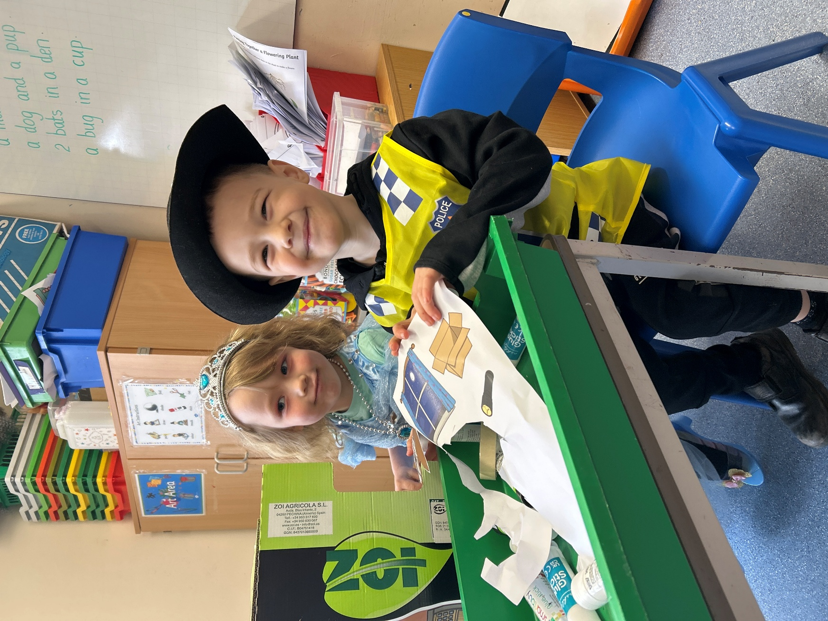
Welcome to Owls class
2025-2026
Tuesday 27th June

Slide 2
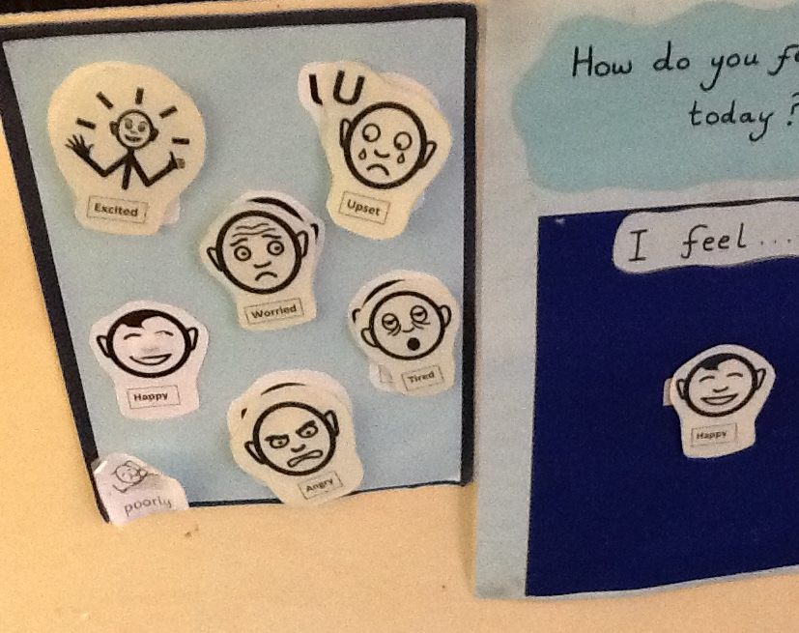
BE SCHOOL READY 2025
Welcome to one of the most exciting (and nerve-racking) parts of your parenting journey! While the focus will be on getting your little one ready to start school, don’t forget to prepare yourself as well for this transition.
We have a class dojo and WhatsApp group you’ll be able to join to make new friends and useful contacts. We also have a school Facebook page to keep you up to date.

Slide 3
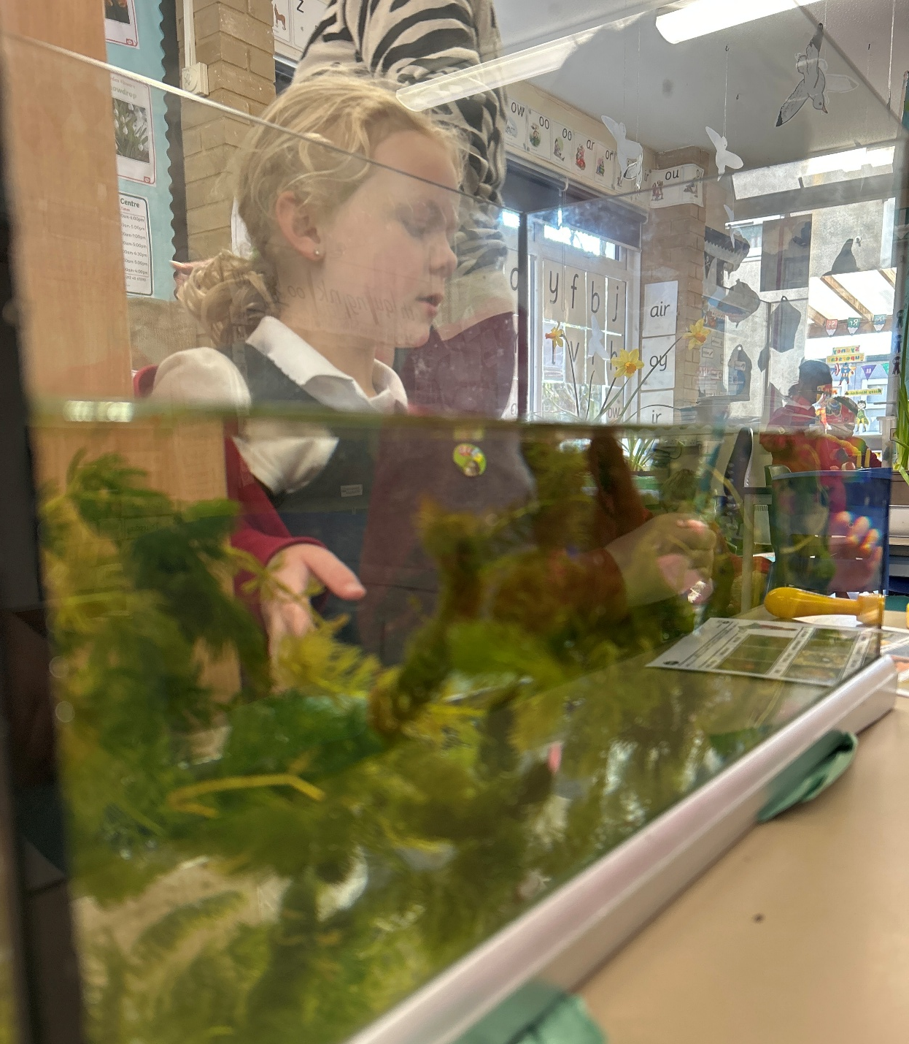
Preparing your little ones for a big step
Every child is different. Some rush to the school gates from day one, and others take a little while to warm up to a new routine. You can do lots of things to prepare them for the start of school.
Have a strong and stable routine.
There are no ‘good’ or ‘bad’ feelings. Help your child to describe their feelings and have healthy conversations.
Read books at home about children starting school at bedtime or playing make-believe games about it.
Bigging up school. Have conversations about and show enthusiasm for school. Even if your own memories of school aren’t happy ones.
Remind your child that they’re classmates will be new too.
Getting to know their future besties. Ask your child to think about the new friends they will make. Invite a child on a play date over the summer holidays. Organise a BBQ at Great Wood.
Practice listening skills and following directions with your child, such as asking them to fetch something or put something away. Talk to them about how they should never be afraid to ask for help or let an adult know if something bad has happened.

Slide 4
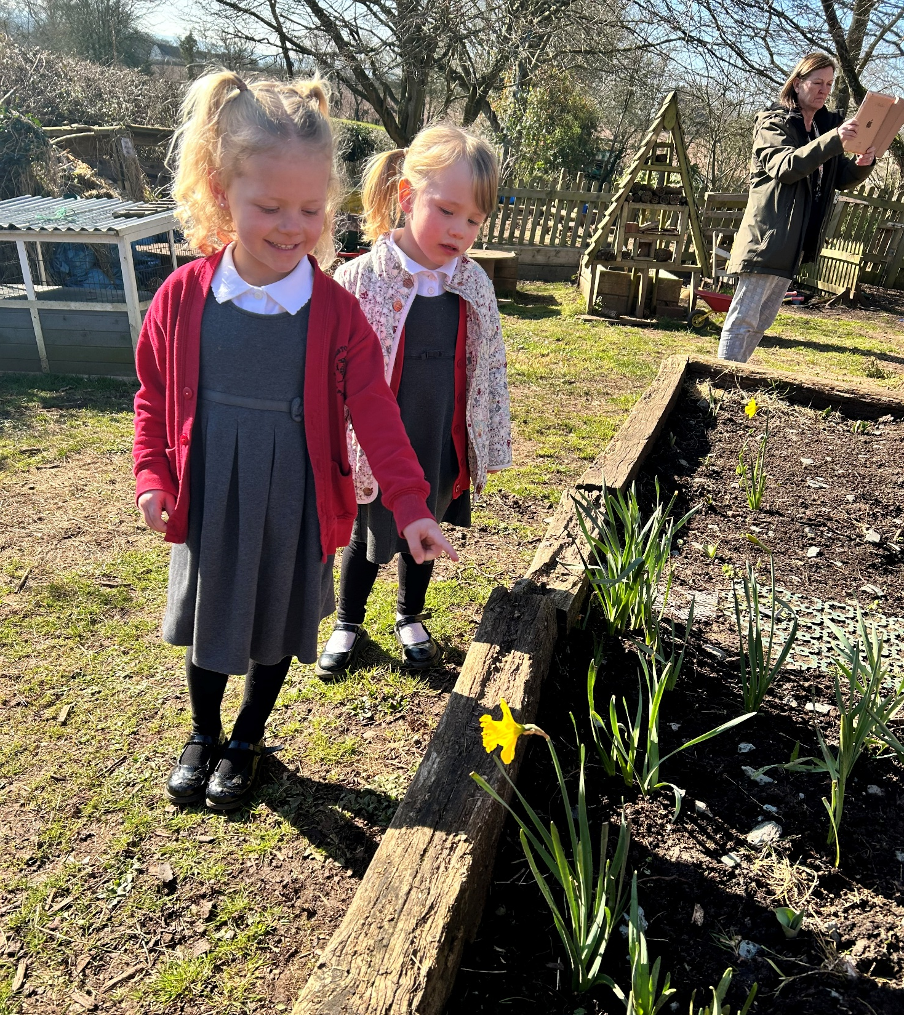
School Shopping List
Name labels or waterproof markers.
A warm winter coat and a light weight-raincoat for the summer.
Spare clothes (just in case).
Summer hat.
Comfortable school shoes, suitable for running.
Hat, scarf and gloves.
Hair tie (for long hair).
PE kit. Drinks bottle (not in bookbag).
Wellie boots.
Make sure they’re wearing suncream.

Slide 5
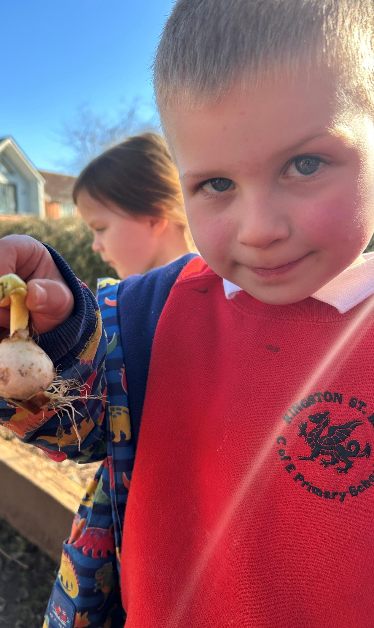
The building blocks of learning
While your child won’t be expected to be able to read, write or do sums, there are some learning milestones that will help your child get off to a great start at school.
Recognise their own name.
Hold a pencil.
Recognise some letters.
Recognise some numbers.
Name colours and shapes.
Say please and thank you.
Follow instructions.
Use the toilet alone.
Wash their hands with soap.
Wipe their nose and put the tissue in the bin.
Put their shoes and coat on.
Dress themselves.
Eat with a knife, fork and spoon.

Slide 6
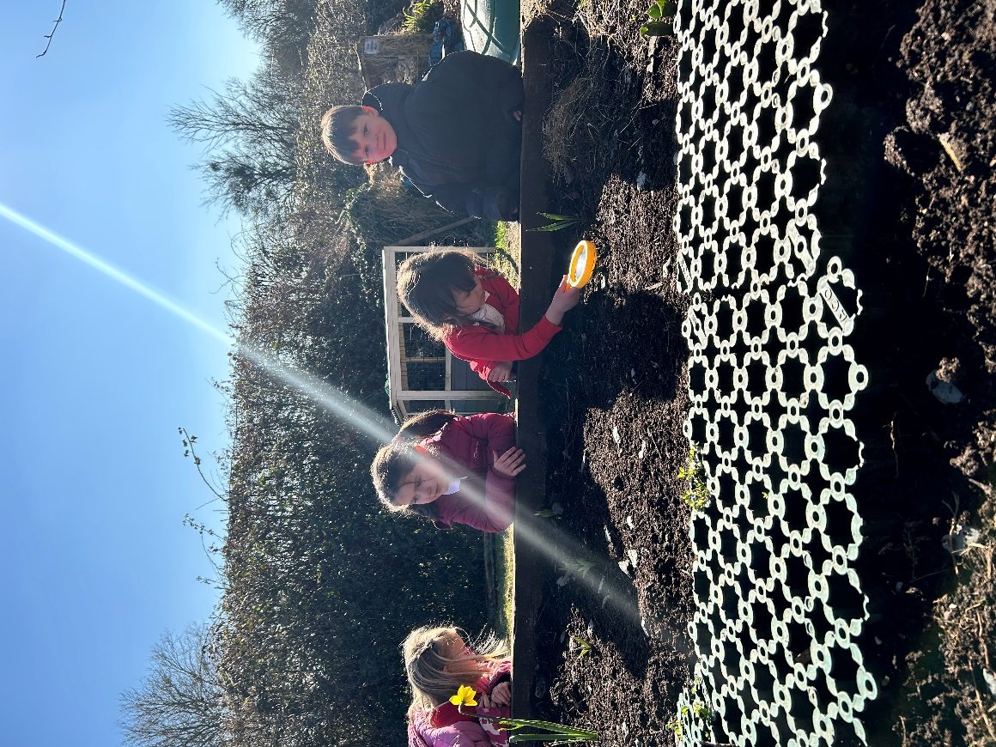
The first day
Get everything ready so there’s no last-minute panics in the morning.
Remind your child how clever/big/brave they are.
Take lots of photos of your child looking adorable in their uniform.
Try to get out the door with plenty of time to spare.
Be strong and cheery on the journey in, it will help your child feel confident.
Say a quick goodbye, especially if you feel your chin start to wobble.
Say hi to other parents and share the experience.
Expect your child to be tired.
Take a snack when you pick them up.
Be prepared for a few meltdowns. This is sometimes called ‘After school Restraint Collapse’ (and it can happen long after reception age).
Cook a special yummy dinner.

Slide 7
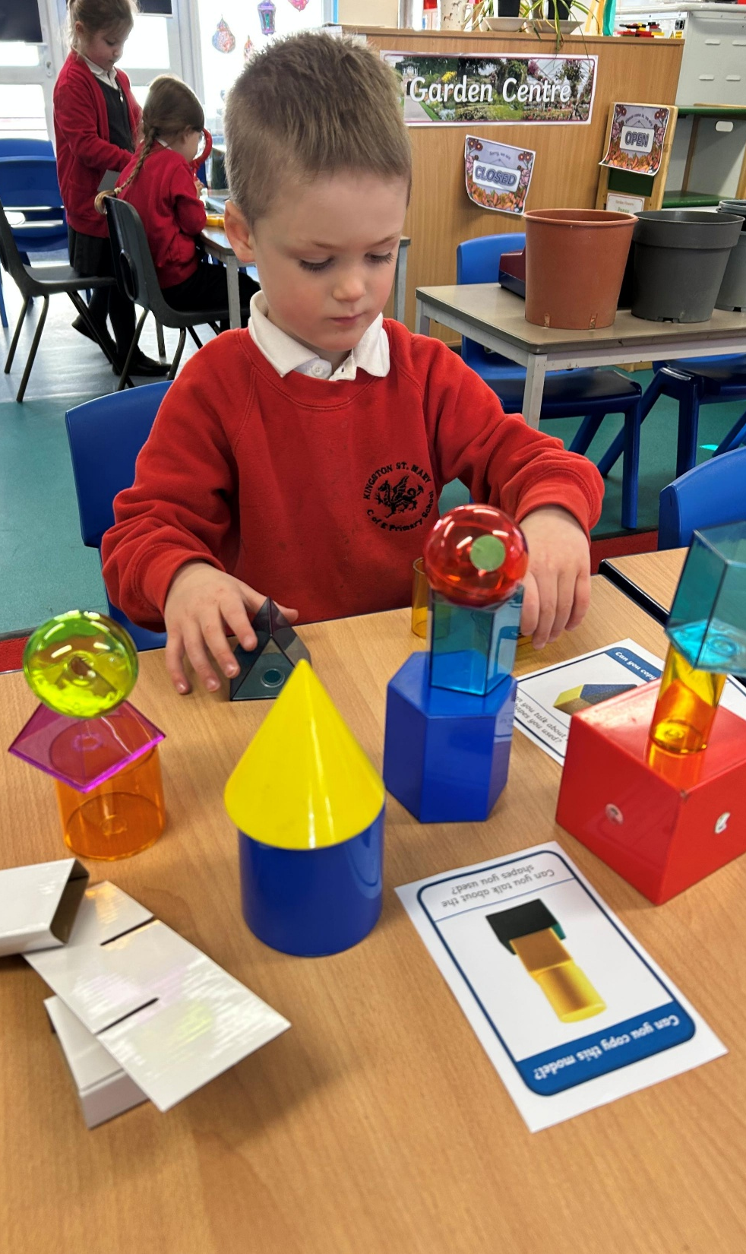
Learning at home
Your child will do better, achieve more and feel more confident if you’re connected and involved with their school life.
Encourage little book worms! Children who read for fun every day perform better in reading tests, develop a broader vocabulary and increase their general knowledge.
Conversations for curious minds. You can build up your child’s curiosity and enthusiasm for learning simply by talking with them and asking them questions.
Will there be homework? Studies show that parents getting involved with their child’s schoolwork really helps to speed up development.
Don’t get it? Don’t worry!

Slide 8
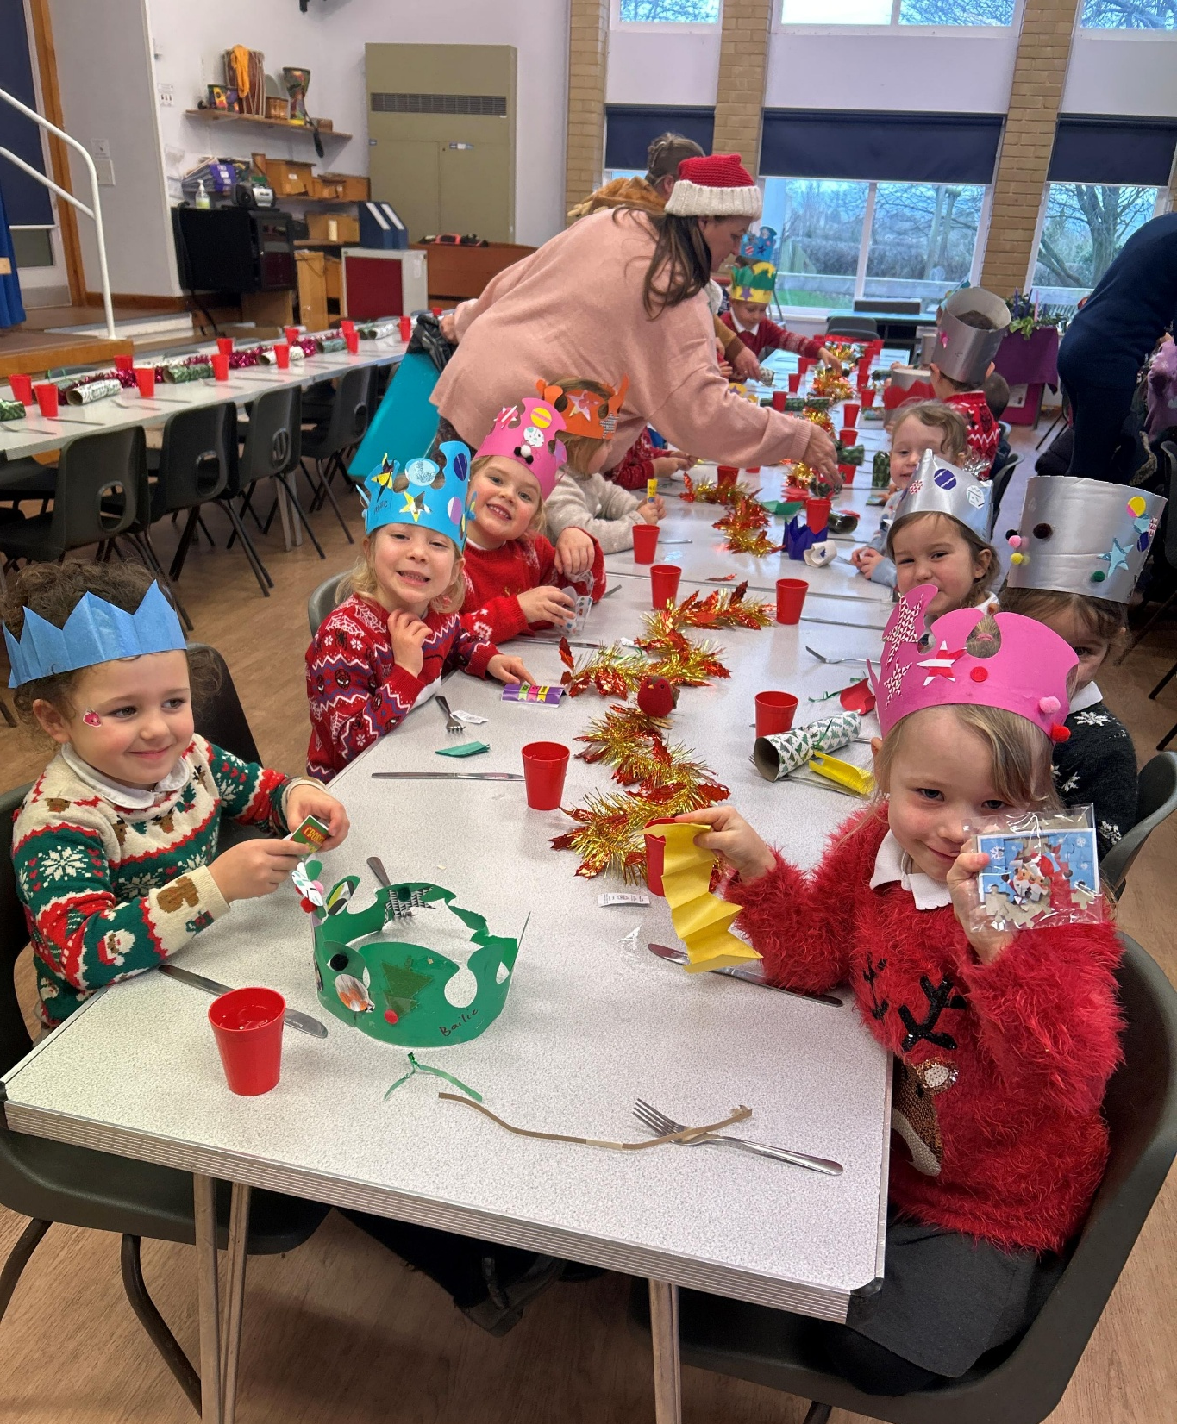
Snacks, food & other experiences
Fresh fruit and milk are available every day, although it might be helpful to send in another healthy snack just in case.
Children should bring a named water bottle from home every day. Please ensure that this contains water and not juice.
Children who wish to bring a packed lunch to school may do so. We are a healthy school and as such we ask that pack lunches contain a balanced diet with no chocolate bars, sweets or fizzy drinks.
There are pupils in school with nut allergies and as such we are a nut free school and ask that food sent in does not contain nuts (no peanut butter sandwiches, nut bars, etc).

