Slide 1
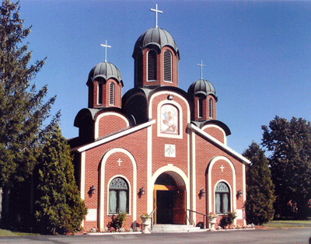

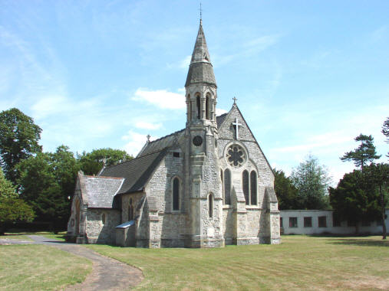
This Photo by Unknown Author is licensed under CC BY
This Photo by Unknown Author is licensed under CC BY-NC-ND
This Photo by Unknown Author is licensed under CC BY-NC-ND

Slide 2
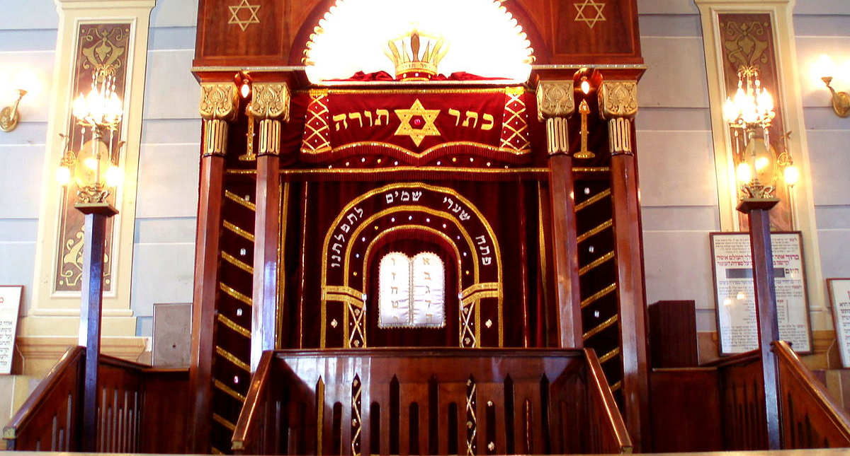
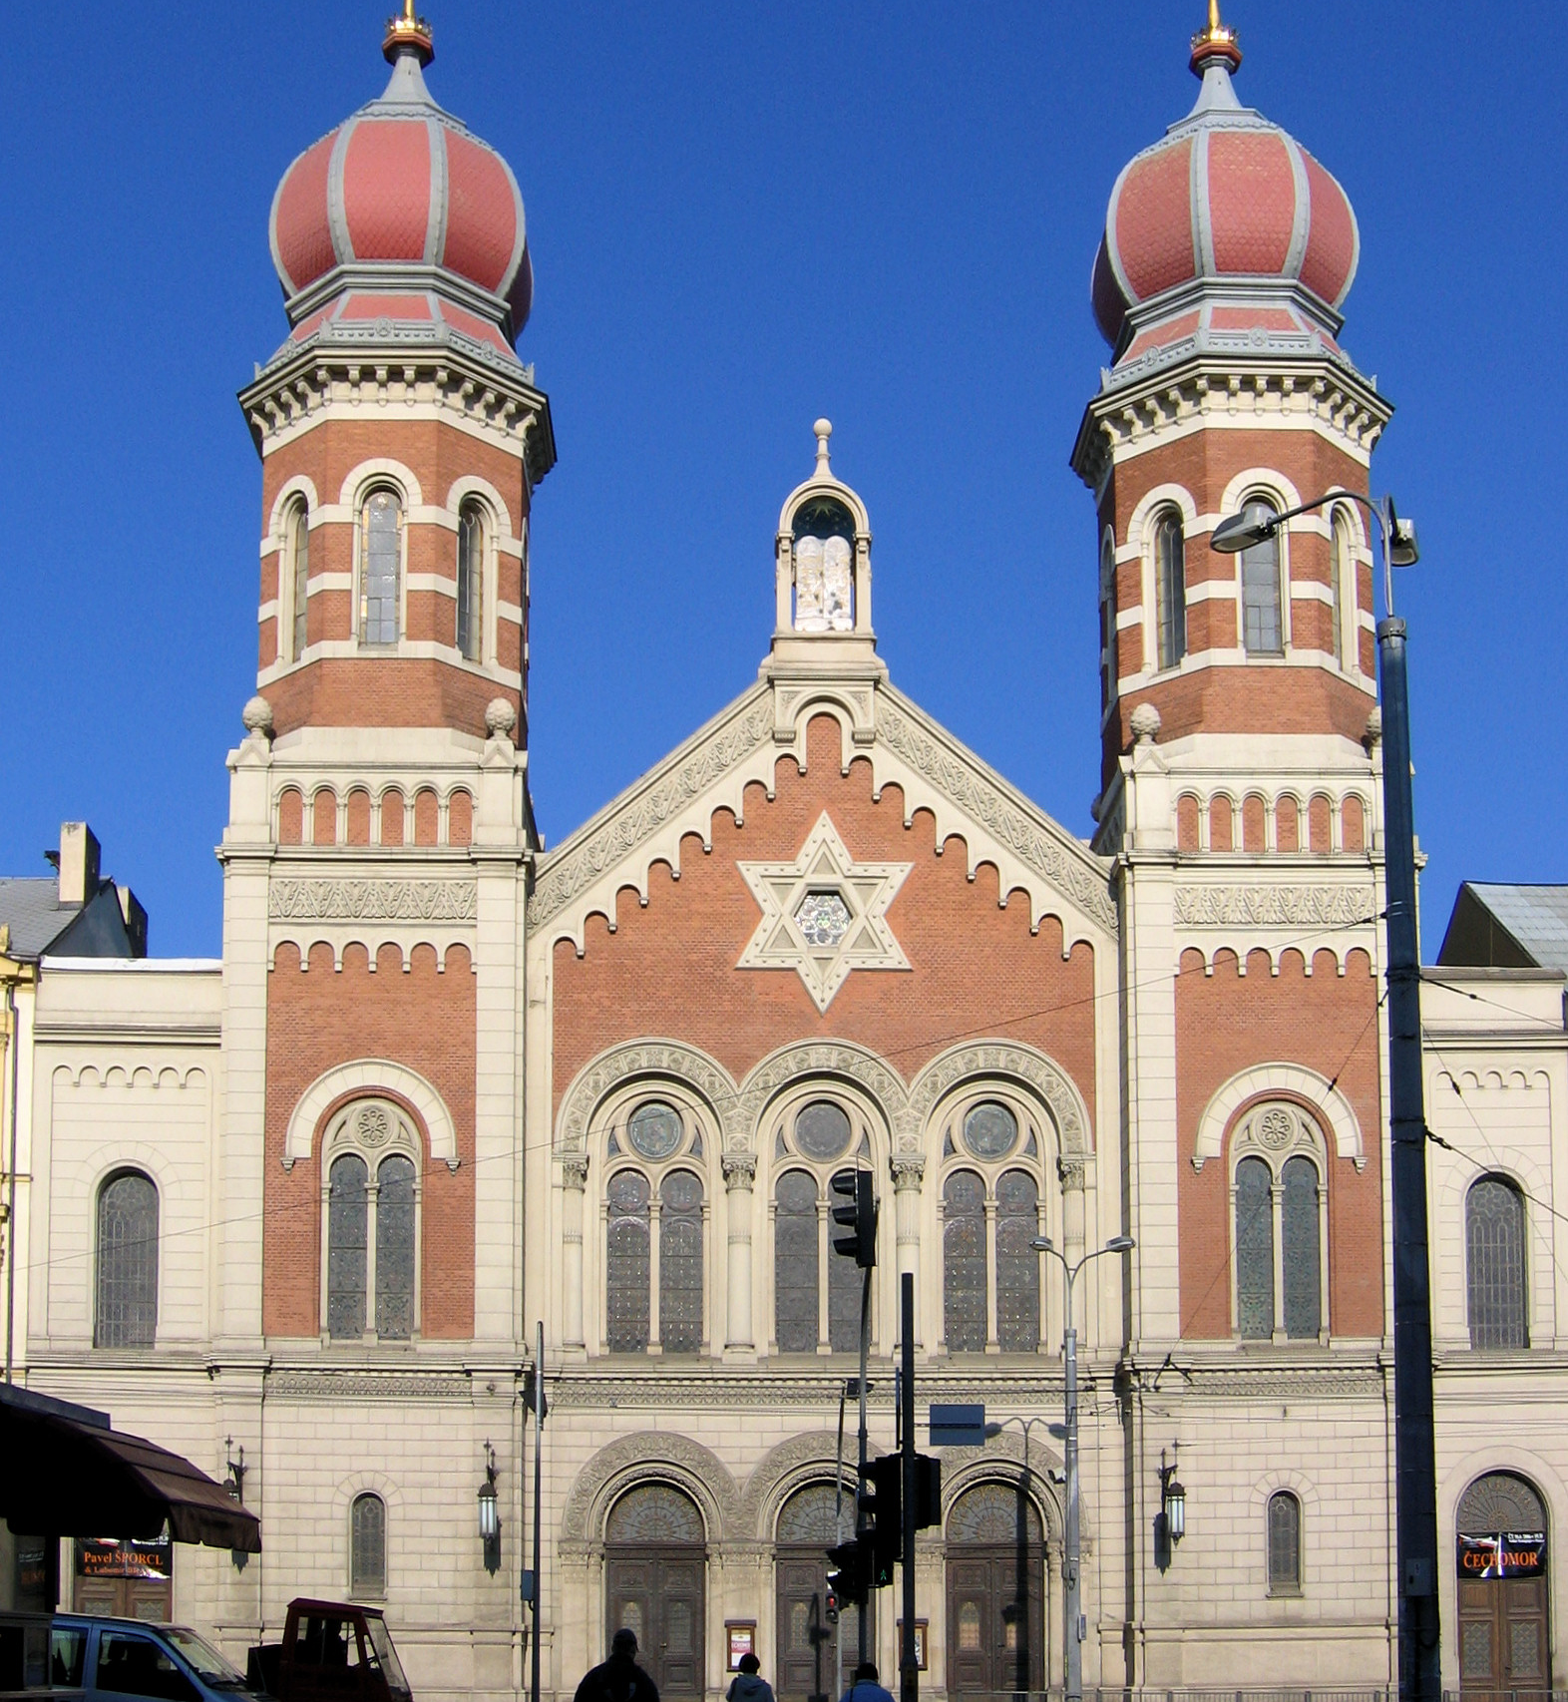
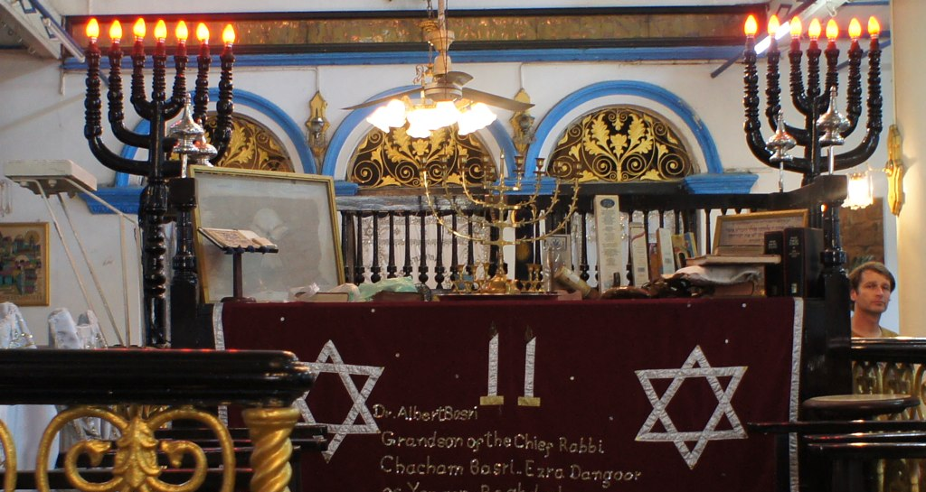
This Photo by Unknown Author is licensed under CC BY-SA
This Photo by Unknown Author is licensed under CC BY-SA
This Photo by Unknown Author is licensed under CC BY-SA

Slide 3
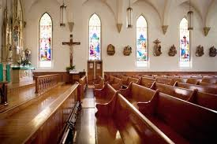


Christian people

Slide 4
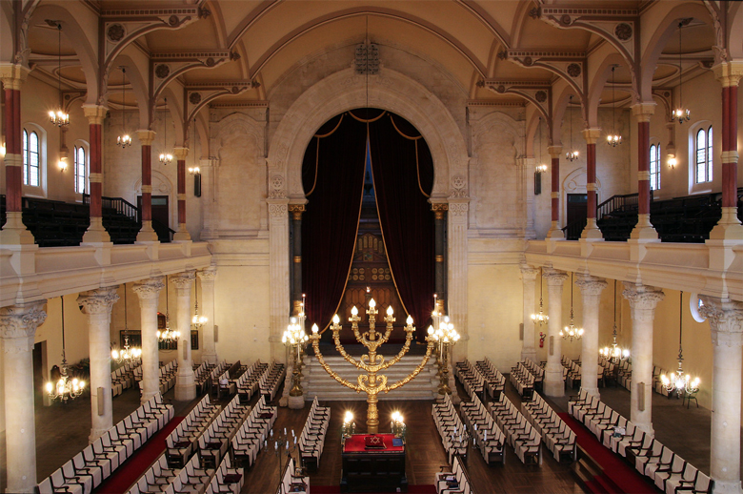

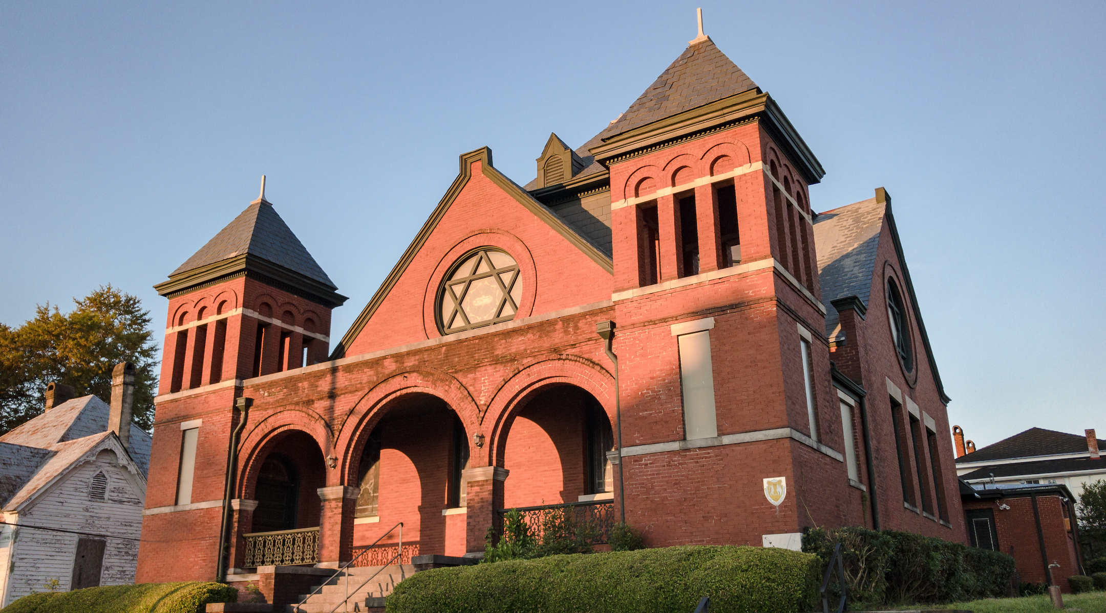
Jewish people.

Slide 5


Slide 6


Slide 7


