Slide 1


Slide 2
What is phonics?
https://www.ruthmiskin.com/en/find-out-more/parents/#lg=1&slide=0
Phonics is a way of teaching children how to read and write. It helps children hear, identify and use different sounds that distinguish one word from another in the English language.

Slide 3
What is Read Write Inc?
https://www.ruthmiskin.com/en/find-out-more/parents/#lg=1&slide=1
Read Write Inc. (RWI) is a phonics based programme, developed by Ruth Miskin, which helps children learn to read whilst also developing a wide range of vocabulary and encouraging a love of stories.
The RWI programme is for primary school children learning to read. Children will begin the programme in Reception and will remain on the programme until they are reading fluently. Our aim is for most children to be off the scheme by the end of Year 2.

Slide 4
How will it work?
In Reception, children will be taught 4-5 sounds a week and will be assessed regularly. When they have reached an appropriate level they will be grouped according to their reading level, and will be taught for up to an hour, when they will start reading and writing alongside the new sounds.

Slide 5
What does the RWI teaching process look like at Kingston St Mary?
Children are first taught the pure ‘Set 1 sounds’ so that they will be able to blend the sounds in words more easily. In school, we call this ‘Fred Talk’. We do not use letter names at this stage; we simply focus on the sounds that are used to sound out words. At this stage, the children are not only taught the ‘sound’ the letter makes but also how to form the letter using a rhyme and a picture prompt. When using these sounds to sound out words in ‘Fred Talk’ we do so like this: m-a-t (mat) c-a-t (cat) f-r-o-g (frog)

Slide 6
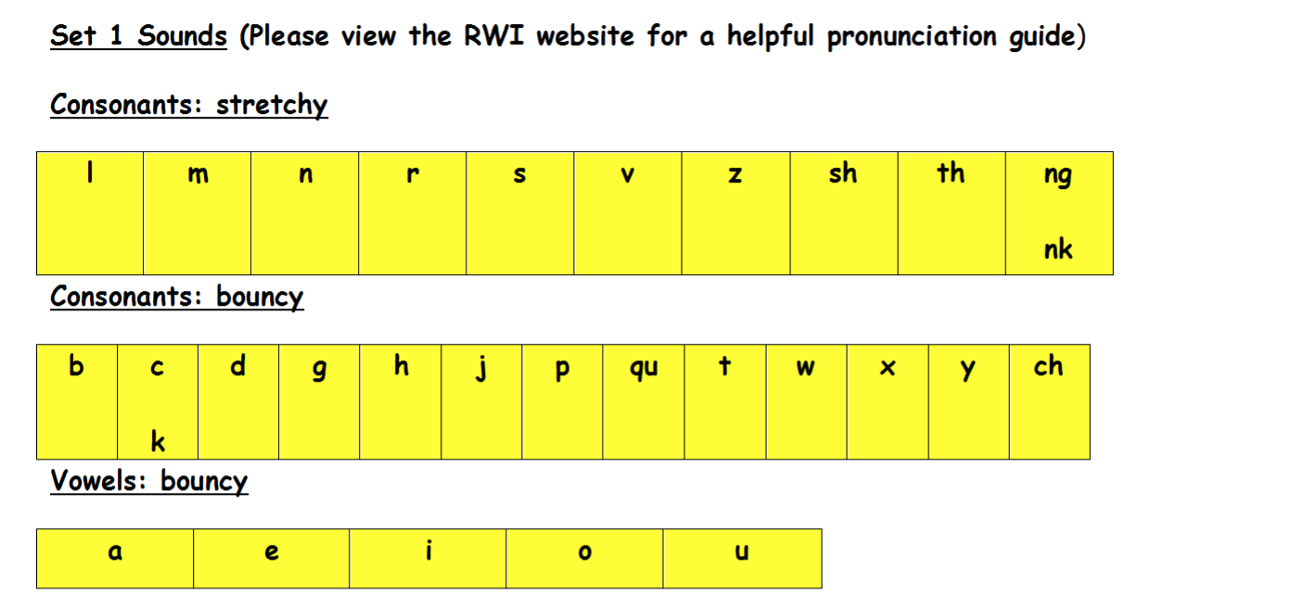
Once your child knows all the Set 1 sounds and is able to read words using ‘Fred Talk’ they will move into a group where they will begin reading simple ‘ditties’ and storybooks and completing writing activities to challenge them further. Your child will also begin to learn ‘Set 2 sounds’.

Slide 7
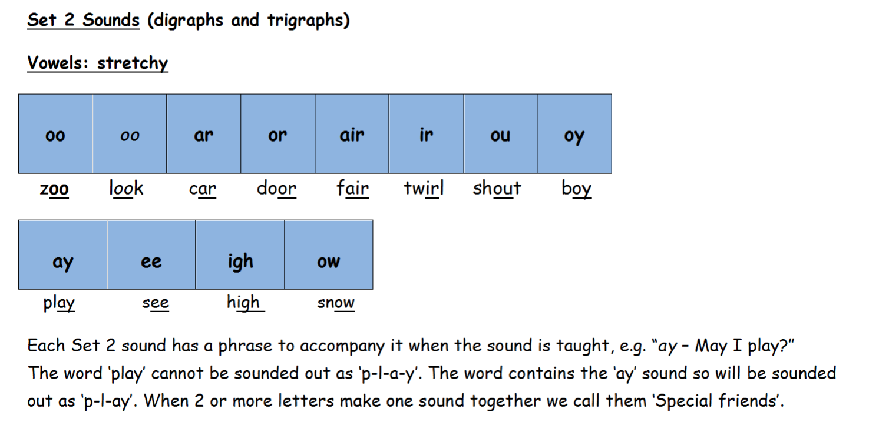

Slide 8
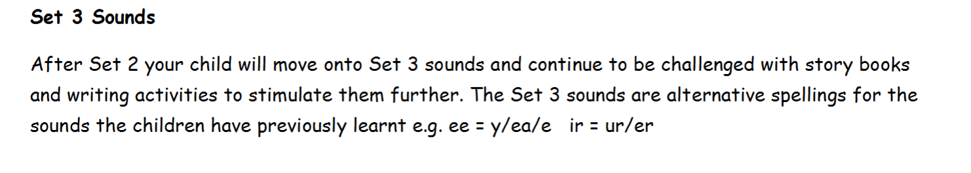
https://www.ruthmiskin.com/en/find-out-more/parents/#lg=1&slide=2

Slide 9
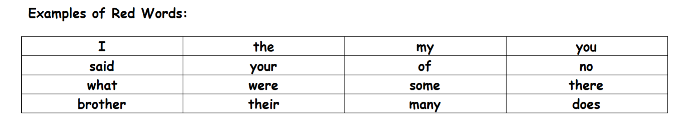
What are Red and Green Words?
Green words are regular words which are spelt phonetically such as ‘cat’ or ‘hop’. Red words are unable to be sounded out and so are irregular (common exception words). Children simply must learn to recognise, read and spell these words as they cannot be sounded out using any sort of phonics strategy. These words are printed in red ink in the RWI books.

Slide 10
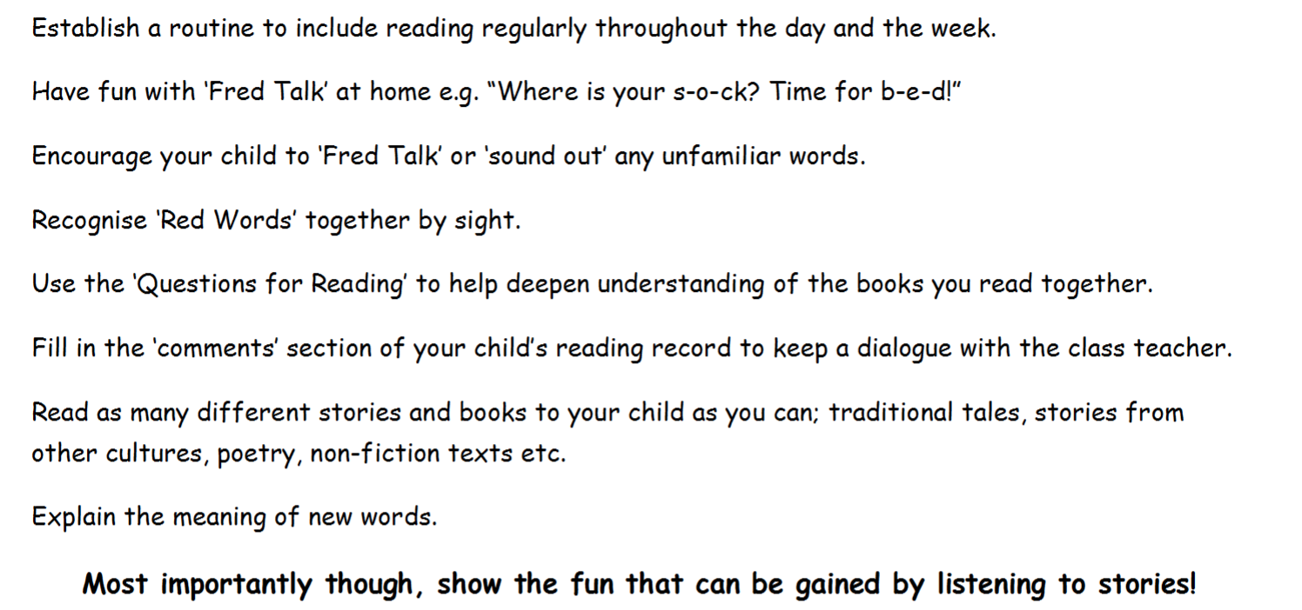
How can you help at home?
https://www.ruthmiskin.com/en/find-out-more/parents/#lg=1&slide=3

Slide 11
Any questions?

