Slide 1
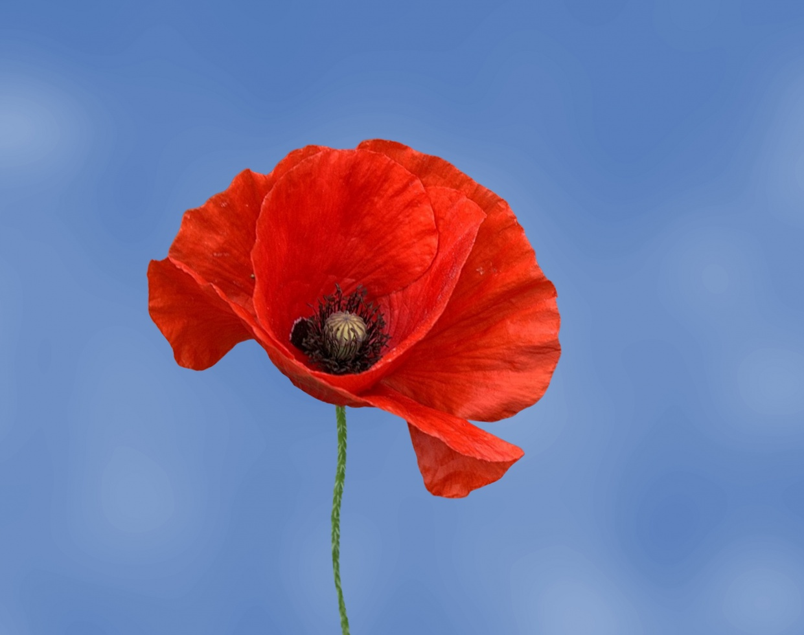
In Flanders fields the poppies blow Between the crosses, row on row, That mark our place; and in the sky The larks, still bravely singing, fly Scarce heard amid the guns below. We are the Dead. Short days ago We lived, felt dawn, saw sunset glow, Loved and were loved, and now we lie, In Flanders fields. Take up our quarrel with the foe: To you from failing hands we throw The torch; be yours to hold it high. If ye break faith with us who die We shall not sleep, though poppies grow In Flanders fields.
What torch for good, for peace, for hope will you help to hold high?
The Bible, Matthew chapter 5 verse 9:
“You’re blessed when you can show people how to cooperate instead of compete or fight. That’s when you discover who you really are, and your place in God’s family.

